Slide 1
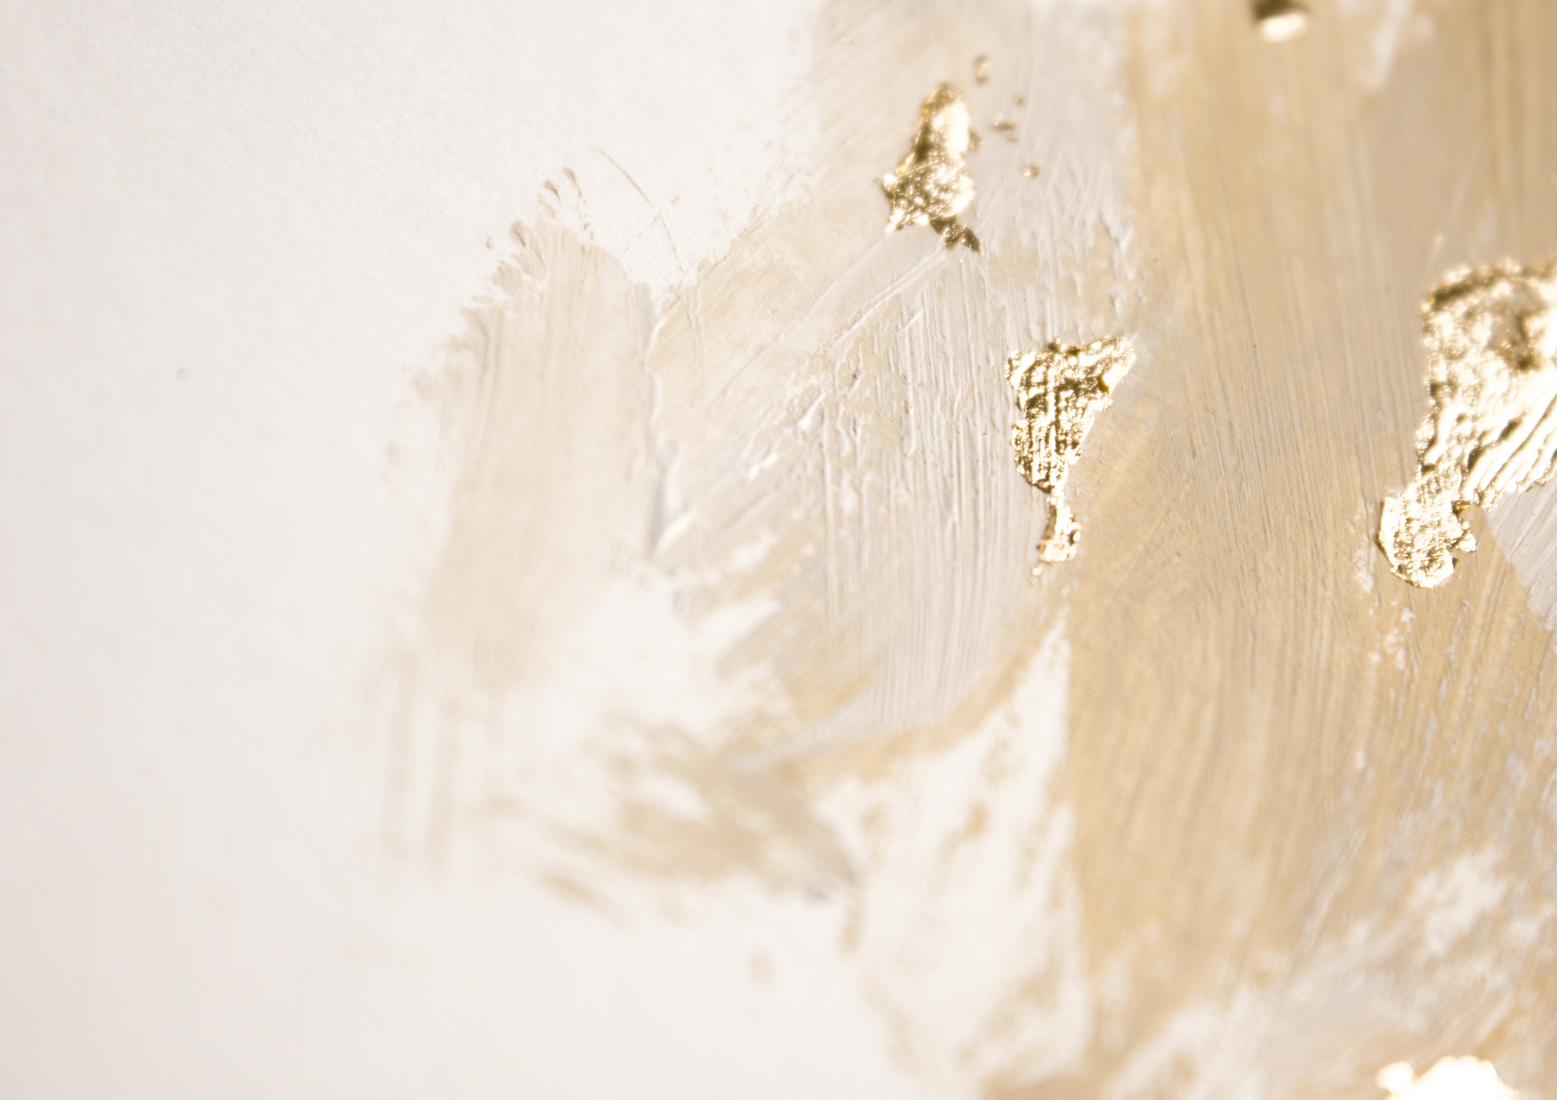










Year 2 Autumn Term 1
ENGLISH
KEY MESSAGES
This term, we will enjoy reading some wonderful books in English. Our focus texts, Little Red and Hansel and Gretel are based on traditional tales but with a twist! The children will build on their stamina for writing, reading their sentences out loud and using capital letters and full stops.
We will be writing our own character descriptions, and non-chronological reports.
MATHS
Welcome to Year 2! We are looking forward to an exciting term ahead and getting to know you all.
Term 1 will focus on the theme of Community. We will be talking about our class names and beginning to make links within the community.
The children will be given reading records for their reading at home. Please keep these safe in the plastic zippy wallets that will also be provided. Books will be changed every Friday.
In Term 1 we will be learning about number and place value. We will be thinking about partitioning numbers and using number lines.
We will then be moving on to addition and subtraction, including number bonds.
Term 1 texts

Slide 2

Year 1 Autumn Term 1
HOME LEARNING
Home learning for year 2 consists of EdShed and TTRS/Numbots learning platforms, as well as weekly phonics homework.
GEOGRAPHY
PSHE & RE
In Geography, we will begin the term by learning about the 7 continents and what makes them unique, moving on to the 5 oceans. We will be learning some catchy songs to help us remember them!
Towards the end of term we will be learning about the United Kingdom.
In RE we will begin thinking about what we can learn from sacred books such as the Bible.
For PSHE, we will look at different topics that link with safety.
PE &
FOREST SCHOOL
PE and Forest School for both classes will be on a TUESDAY. Please ensure all items of clothing are clearly named!
REMINDERS
Tuck Shop
Please may any tuck shop money be brought in in a named envelope.
Book Change
Reading books will be changed every Friday. Please ensure reading records and books are brought in each Friday.
SCIENCE
COMPUTING
Add here
Science for this term will be all about habitats! We will think about the habitats in which different animals live.
In computing this term we will be thinking about how Information Technology is used at home, school and in the wider world.
MUSIC
In music we will be learning to play the glockenspiel, listening to music and singing.

