Slide 1



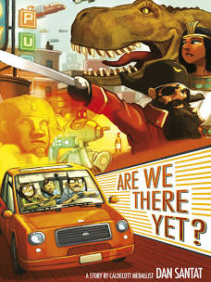



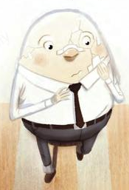


Year 2 – Term 2 – Book Warmer
‘After the Fall’ by Dan Santat
Here are some other stories written by Dan Santat:
This tale follows Humpty Dumpty, an avid bird watcher whose favourite place to be is high up on the city wall…that is, until after his famous fall. Now terrified of heights, Humpty can longer do many of the things he loves most. Will he summon the courage to face his fear?
Character description
What does our character Humpty look like?
What is he wearing?
What features does he have?
Can you create a character description?
e.g Humpty has a long, smart and black tie.
Our theme this term:
In the story, it says that some parts of Humpty couldn’t be ‘healed’ after the fall. Can you find out what this word means?
The Arts

